Slide 1

Shooting for the (Sprint) Goal
The importance of setting good sprint goals in scrum
Notes:
How many people here currently work in Scrum or some form of Scrum?
How many people have had formal or informal Scrum training? Good because no-one will notice if I get anything wrong!
How many people are familiar with the concept of a Sprint Goal?

Slide 2
Paul Axon
blog.paulaxon.co.uk
www.linkedin.com/in/axon-paul
Worked in various scrum teams on and off for over 10 years
Gained Scrum Inc Registered Scrum Master certification in 2021
Notes:
Doing the qualification was interesting because Scrum is constantly evolving as they see more companies adopt the process and can see what works and what doesn’t
Don’t claim to run perfect Scrums – learnt a lot researching this talk, reflected and will take some of these practices into future scrums myself

Slide 3
Shooting for the (sprint) goal
What is a Sprint Goal and who sets it?
Why is it important?
How can we set better Sprint Goals?
What challenges do we face?
How does this apply to me?
Notes:
Maybe you aren’t doing Scrum
Maybe your company mandates certain practices that you can’t change
Are there any of the points in this talk you can take in to your team

Slide 4
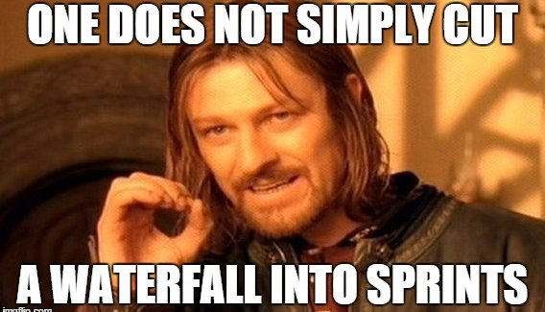
What is scrum?
Scrum Guide Definition:
A Product Owner orders the work for a complex problem into a Product Backlog.
The Scrum Team turns a selection of the work into an Increment of value during a Sprint.
The Scrum Team and its stakeholders inspect the results and adjust for the next Sprint.
Repeat
Notes:
I want to draw attention to the 2nd point here. The team turns a selection of the work in to an “Increment of value”. What does it mean by an increment of value?

Slide 5
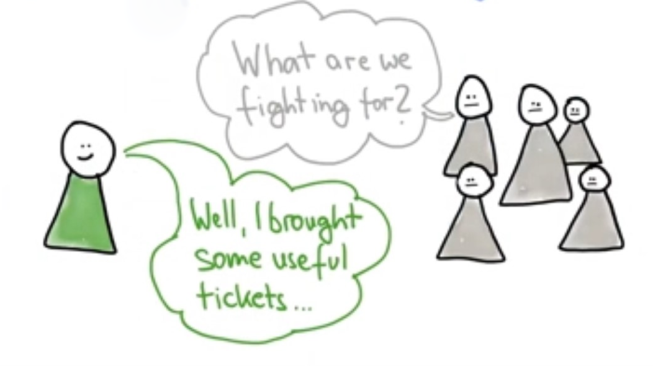
The Sprint Goal
At Sprint Planning the Scrum Team ask “Why is this sprint valuable?”
What will I be able to do with the product at the end of the sprint that I can’t do now?
The Sprint Goal tells you “why” you are doing the work, e.g. “Update My User Details”
In order to achieve the Sprint Goal we select a set of Backlog Items – the “what” – e.g.
Change my email address
Change my password
Add an avatar
Note that the Scrum Team sets the Sprint Goal – this is the team’s Commitment for the next Sprint
Notes:
The fact that the Scrum Team sets the Sprint Goal is important
How many people set a Sprint goal – instead of just selecting the top stories on the backlog?

Slide 6
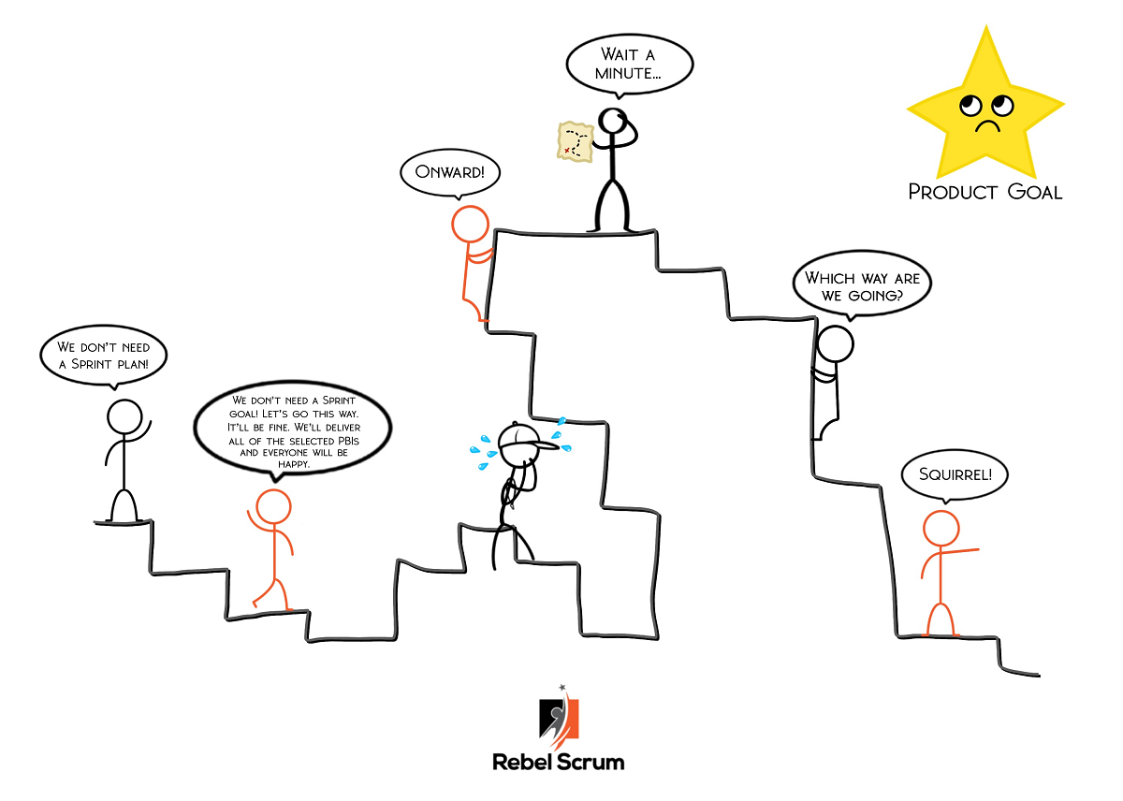
Why Set A Sprint Goal?
The Sprint Goal is the single objective for the Sprint
At the daily stand up the team replans to ensure they are on track to deliver the Sprint Goal
If the work turns out to be different to what was expected the team can negotiate with the Product Owner to change the scope of the backlog as long as that does not affect the Sprint Goal
E.g. we could deliver “Update My User Details” without “Add an avatar”
Setting a Sprint Goal allows the team to collaborate and innovate on delivering functionality without obsessing on completing a fixed number of work items
Notes:
This is a powerful concept
We are concentrating on delivering a useful and working bit of functionality to the customers or stakeholders
The stakeholders don’t care how many tickets got closed
The purpose of the Sprint Review is to demonstrate the Sprint Goal
The purpose of the Retrospective is to work out how to improve our ability to achieve Sprint Goals.

Slide 7
Benefits of a Sprint Goal - focus & COHERENCE
I know why I am doing the work I’m doing
I can innovate to deliver the best solutions
Without a sprint goal I just have a bunch of “things” to do – a Sprint Goal gives me purpose
The team works together to deliver the product increment
Increase Teamwork
Reduce siloing
Notes:
We’re all experienced developers – why would the business tell us how to solve problems – that’s why they hired us, right?

Slide 8
Benefits of a Sprint Goal - Delivering something useful every sprint
Getting used to success
Who doesn’t want to succeed every two weeks instead of waiting months and months to see if what we’ve done is correct?
Better estimation
We know what functionality we’ve delivered not just what tickets got closed
More opportunities to get feedback on what we’ve built
The first principle on the Agile Manifesto is “Our highest priority is to satisfy the customer through early and continuous delivery of valuable software”
If what we’ve built is wrong, never mind because we have an opportunity to pivot and try something else
More opportunities to tell if we are on track

Slide 9
Benefits of a Sprint Goal - Better meetings
Daily Scrum
An opportunity to review progress toward the Sprint Goal and replan as necessary to ensure it is delivered
This may mean adjusting the Sprint Backlog
The team can replan throughout the day as necessary
Sprint Review
Is no longer just a bunch of unrelated “things” that were done it now has a focus
Did the team achieve the Sprint Goal?
Sprint Planning
Has a purpose – what is the Sprint Goal and how will we achieve it?
Retrospective
Did we achieve the Sprint Goal?
If yes, did we do anything different that helped us?
If no, is there anything we could do differently next time?

Slide 10
Setting better sprint Goals
Useful/Valuable
Has an “Outcome” rather than “Output” (i.e. number of tickets closed)
Measurable
Flexible
Achievable
Does not prevent you from doing other work, e.g.
Unplanned work
Tech Debt
Bug Fixes
Determined by the whole Scrum Team

Slide 11
Challenges/Objections
We can’t set a single sprint goal
Everyone is working on a different area of the product
Everyone is working on different projects
We can’t fit the work in to a sprint
We need to build the back end before we can build the front end
We don’t understand the Product Goal
We don’t have enough stories groomed

Slide 12
How does this apply to me?
d

